Slide 1
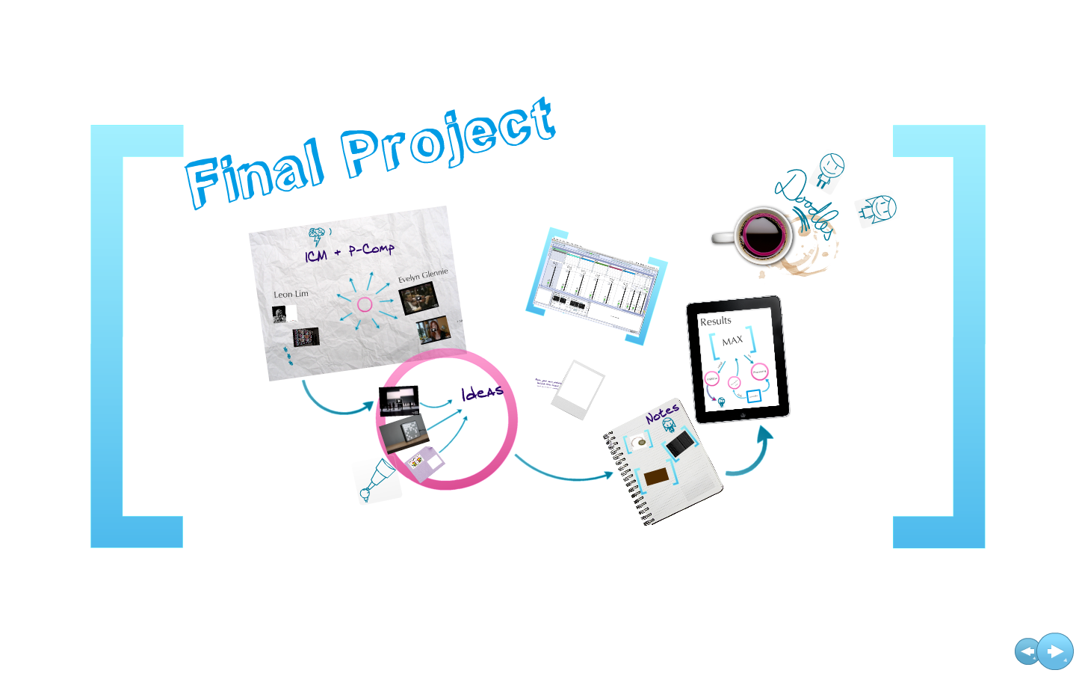
BIKENET.RO
Presented by:
Ioana Adela Borbely

Slide 2

Bike Sport is a Romanian shop located in Cluj-Napoca specialized in the marketing and service of Mountain Bike type bicycles and not only.
Dealer SPECIALIZED, MERIDA, SCOTT, CANNONDALE SPECIALIZED Test Center, MERIDA, SCOTT. Authorized service and warranty assessment center for all bicycles and SPECIALIZED components. Service for a wide range of forks with suspension and shocks.

Slide 3


Testing Types
Functional testing:
Smoke testing
Positive Testing
Negative testing
Exploratory
NON-FUNCTIONAL TESTING:
COMPATIBILITY TESTING
PERFORMANCE TESTING

Slide 4




TESTING TOOLS

Slide 5
TESTING approach
Creation of functional test cases. The test suite contains a subset of test cases which can be run as a smoke test.
Execution of functional test cases & logging of defects.
Exploratory testing
Non-functional testing.
Platforms:
OS: Microsoft Windows 10 (1909 version), Android version 9.
Browsers:
Google Chrome, Opera, Microsoft Edge

Slide 6
TEST CASE OVERVIEW
Shopping bag
Registration
Main menu
Wish list
Password
Search bar

Slide 7
TEST CASES RESULTS
Number of test cases run: 44
Number of test cases passed: 36
Number of test cases failed: 8

Slide 8
BUGS OVERVIEW
The most important bugs were founded in area: registration, main menu, shopping bag, wish list
Number of bugs founded: 20
Main Menu:
0025277
Registration: 0025247
0025251
Shopping bag:
0025264
0025265
Wish list:
0025257
0025258

Slide 9
LESSON Learned
Simple steps are better to use for writing test cases or reporting bugs.
Being organized reduce the time we spend on testing.
The quality of the product is very important.
Don't stop searching, exploring and learning new information.
Exploratory testing is fun.

Slide 10
CONCLUSION
Most of the bugs were founded using exploratory testing
There were a total of 6.80% errors, the average response time is not high, but we can see that the most important features have the highest error percentage response time: Registration, Main menu with 8% and Home category page with 10%.
Overall the product is stable and shippable, but the defects that were found may affect the client’s / users confidence and trust of the overall image of the company.

Slide 11
Thank you for your attention !

